Slide 1
Unit - 1
Perceptron to Neural Network
Prepared by
Mrs. Veena Kiragi

Slide 2
What Is Deep Learning?

Slide 3
What is machine learning?

Slide 4
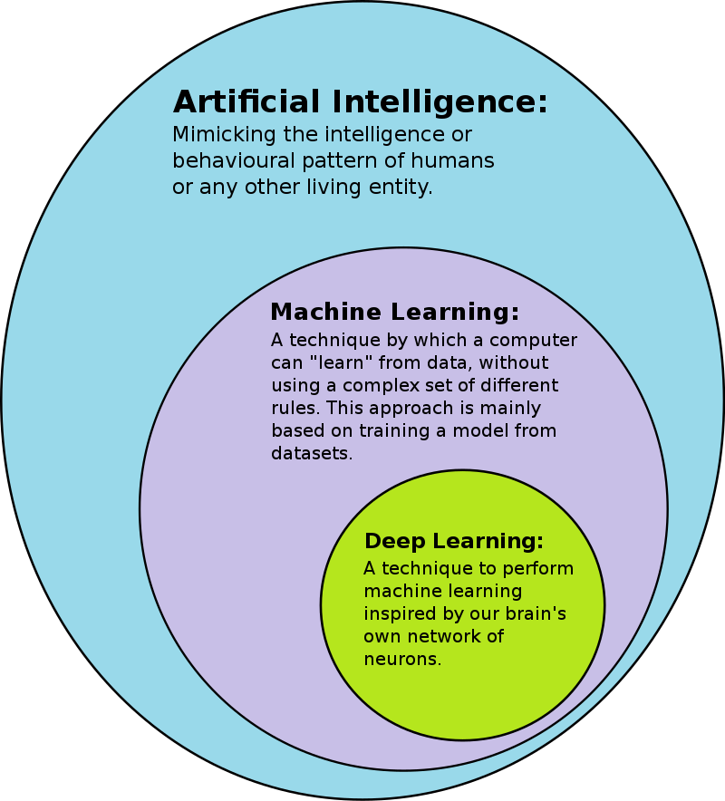
AI-ML-DL

Slide 5
Difference between ML & DL
Data dependency
Hardware dependency
Feature selection
Training Time
Prediction Time

Slide 6
Examples of Deep Learning at Work
Deep learning applications are used in industries from automated driving to medical devices.
Automated Driving:
Aerospace and Defense:
Medical Research:
Industrial Automation:
Electronics:

Slide 7
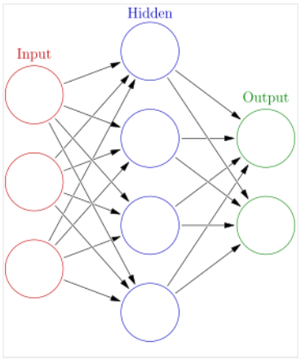
Deep learing (Deep Neural Network):

Slide 8
Deep Learning Success Stories:
Self Driving Cars
News Aggregation and Fraud News Detection
Natural Language Processing
Virtual Assistants
Entertainment
Visual Recognition
Fraud Detection
Healthcare
Personalisations
Detecting Developmental Delay in Children

Slide 9
Colourisation of Black and White images
Adding sounds to silent movies
Automatic Machine Translation
Automatic Handwriting Generation
Automatic Game Playing
Language Translations
Pixel Restoration
Photo Descriptions
Demographic and Election Predictions
Deep Dreaming

Slide 10
https://www.mygreatlearning.com/blog/deep-learning-applications/

Slide 11
McCulloch-Pitts Neuron Model
First computational model
Proposed by Warren MuCulloch (neuroscientist) and Walter Pitts (logician) in 1943

Slide 12
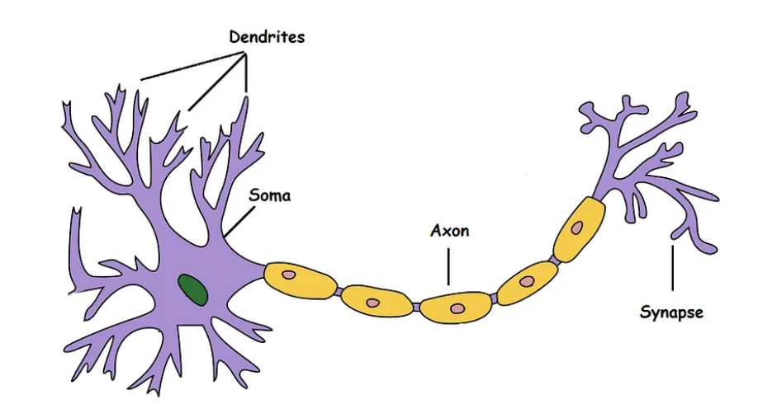
Biological Neurons

Slide 13
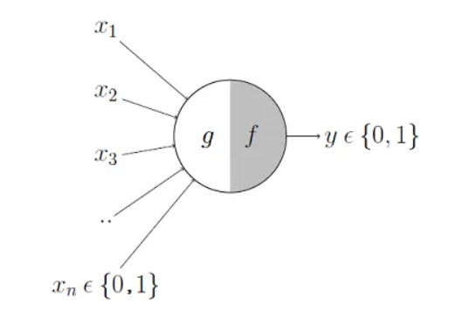

Slide 14
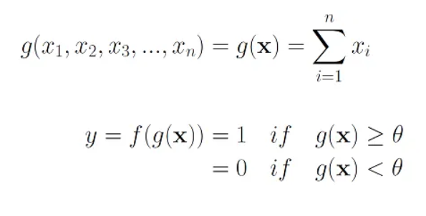

Slide 15
Threshold plays an important role in M-P model
M-P neuron has no particular training or learning algorithm
Used for implementing logic functions

Slide 16
Perceptrons: Early Deep Learning Algorithms
In 1957, Mr. Frank Rosenblatt invented the Perceptron to perform specific high-level calculations.
Perceptron is a single layer neural network and is used in supervised learning.
Perceptron is usually used to classify the data into two parts. Therefore, it is also known as a Linear Binary Classifier.

Slide 17
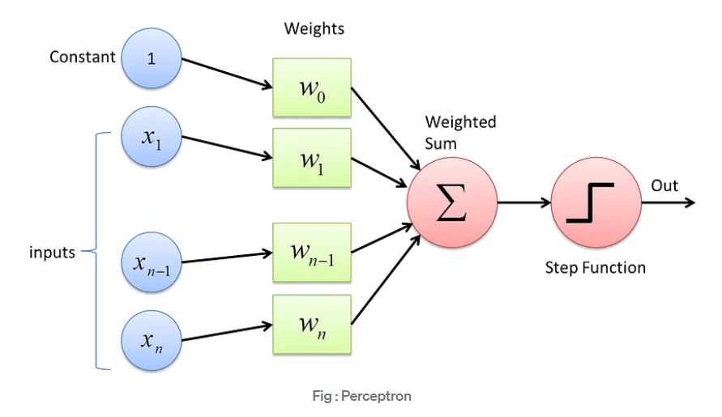

Slide 18
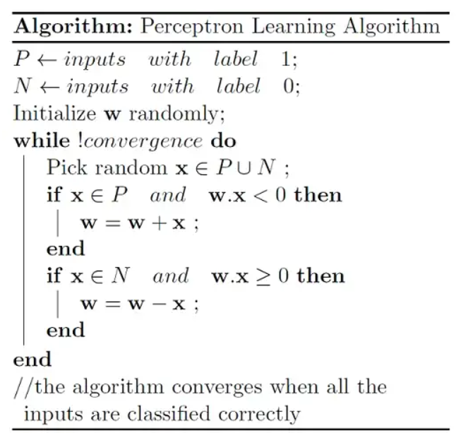
Perceptron Learning Algorithm

Slide 19
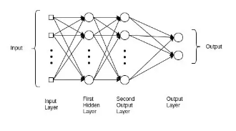
Multilayer Perceptrons (MLPs)

Slide 20
